Slide 1
Docker - Build Custom Image
Hung.Tran

Slide 2
CONTENT
Create docker image
Dockerfile teadown
What is a image base
Build process in detail
Run an example (nodejs application)
Build an example: a counter visit to website

Slide 3
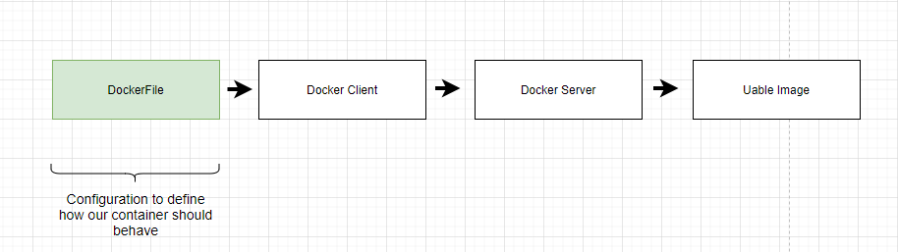
Create Docker Image
Notes:
Docker files is a plain text that have a couple of line of code of configuration placed inside of it.
That configuration is going to define how the container behaves or more specifically, and what is does when it start up as a container.
When the docker file create then the file will pass to Docker Client, which you will recall the Docker CLI using the terminal, and it will provide the file to Docker Server
The Docker Server to look all line of code of configurtion that have inside, and than build a useable image that can be use to create a new container

Slide 4
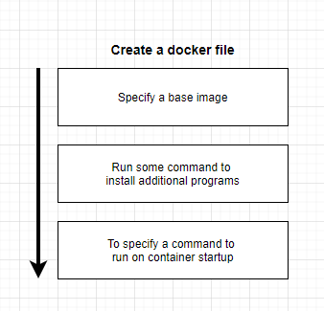
Create Docker Image

Slide 5
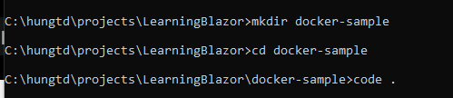
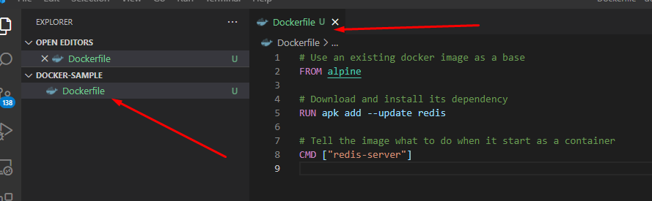
Create Docker Image
Create folder and start vs code to create Dockerfile
Notes:
Create a folder to store docker file
run vs code and create Dockerfile and add some commands into it.

Slide 6
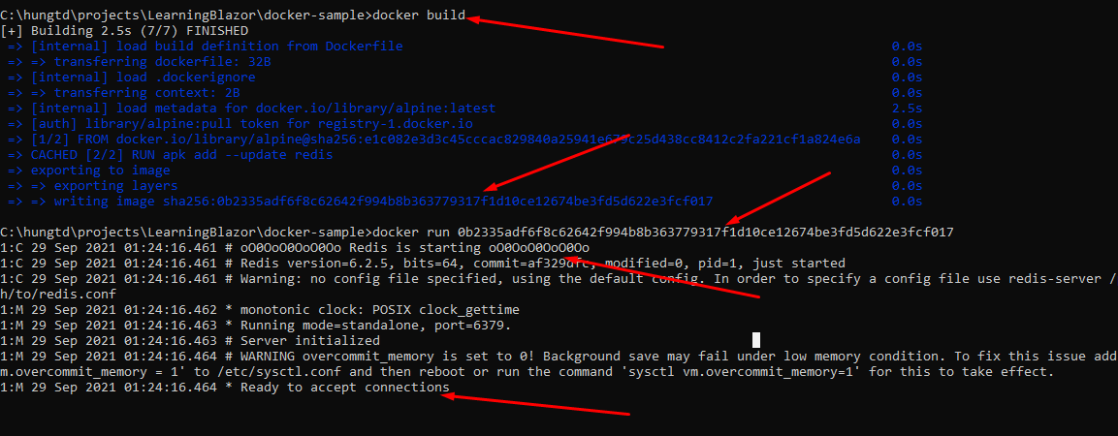
Create Docker Image
Build and run docker file

Slide 7
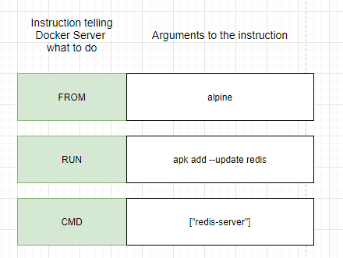
Dockerfile teadown
Notes:
FROM: used to specify the image that we want to use as a base
RUN: used to execute some command while are preparing our custom image
CMD: What should we executed when our image to start up a branch new container

Slide 8
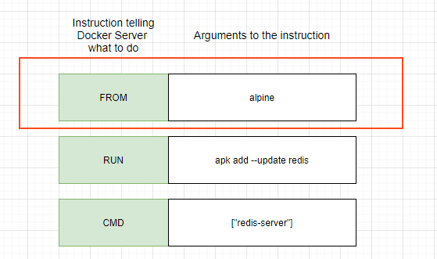
What is a base image?
A base system operation can be windows, MacOS, Linux
It enough dependencies to run an application

Slide 9
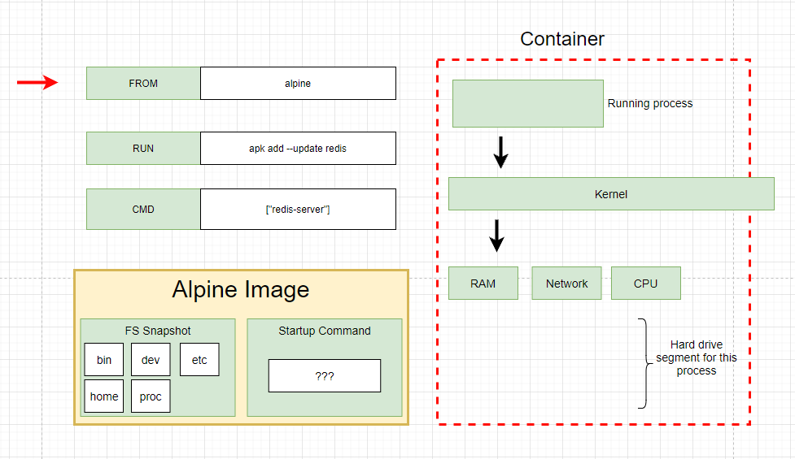
Build process in detail
Step 1: Run “FROM alpile”, download image from Docker Hub and create an image

Slide 10
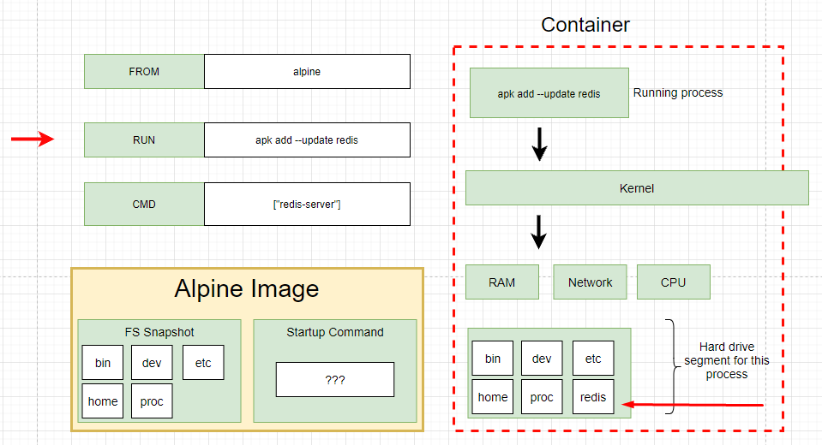
Build process in detail
Step 2: Run “RUN apk add --update redis”, Use image from step 1 and create new temporary container and download redis

Slide 11
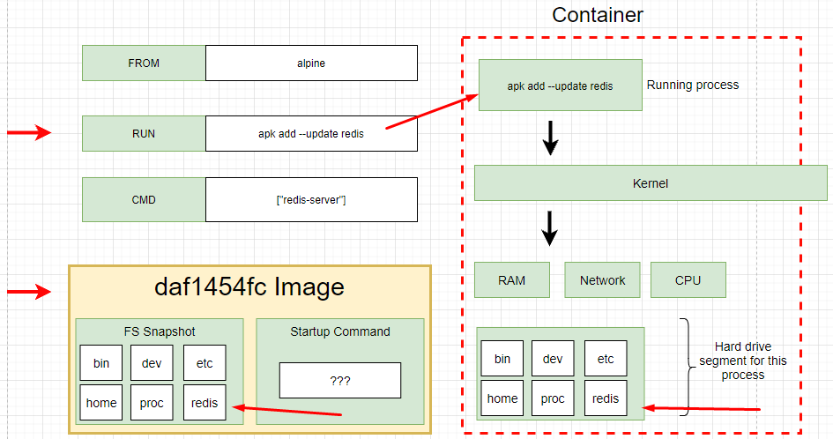
Build process in detail
Step 2: Run “RUN apk add --update redis”, Use image from step 1 and create new temporary container and download redis.
Remove the current temporary container
Take a snapshot and save into new image

Slide 12
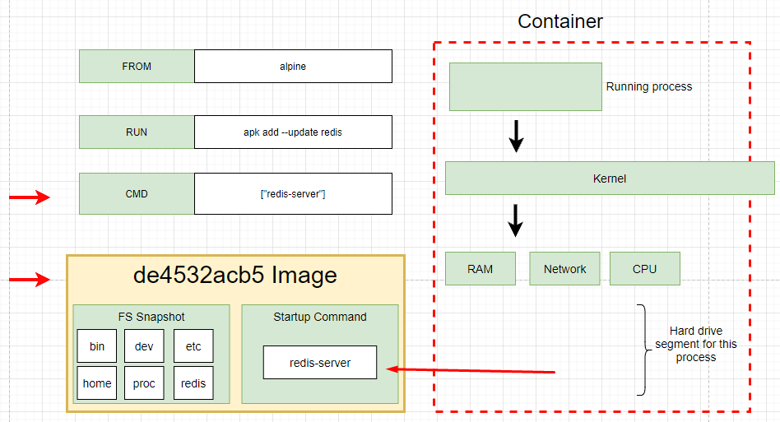
Build process in detail
Step 3: Run “CMD [“redis-server”]”, Use image from step 2 and create new temporary container and setting the primary command or primary process of container.
The primary command is the default command executed when container created.
Take a snapshot and save into new image

Slide 13
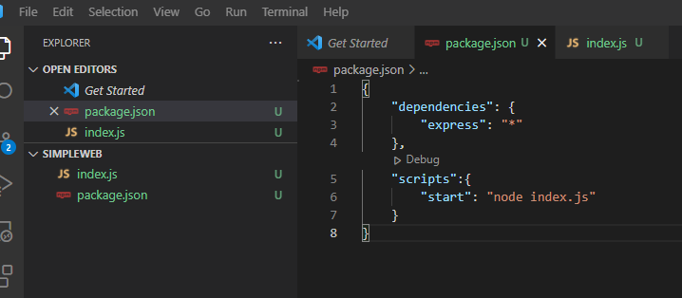
Build docker example (nodejs application)
Adding package.json file

Slide 14
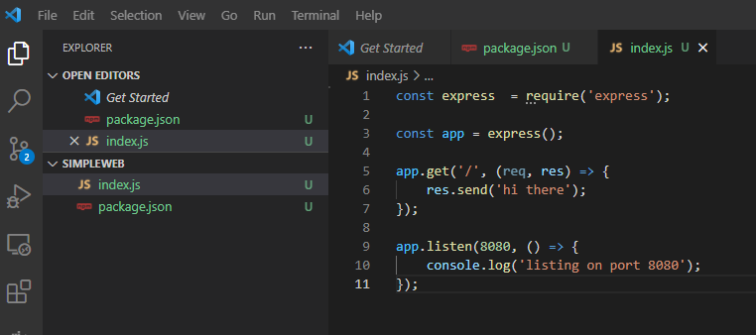
Build docker example (nodejs application)
Adding index.js file

Slide 15
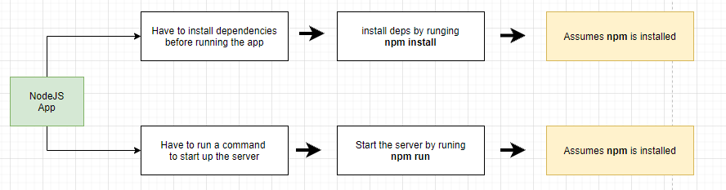
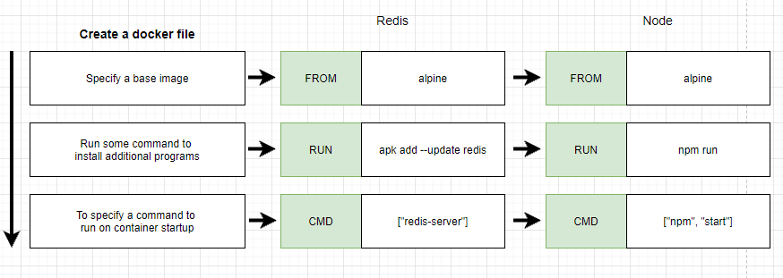
Build docker example (nodejs application)

Slide 16
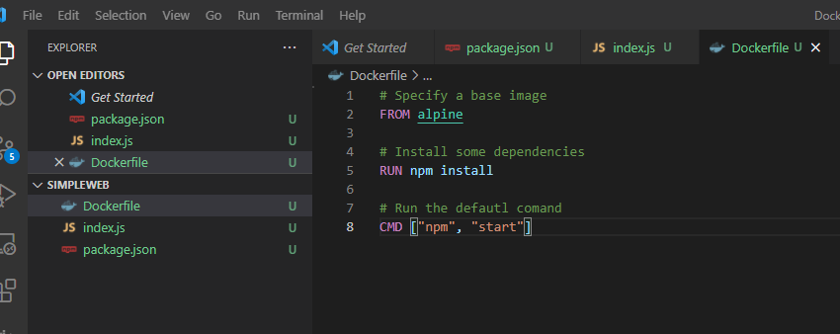
Build docker example (nodejs application)

Slide 17
Build docker example (nodejs application)

Slide 18
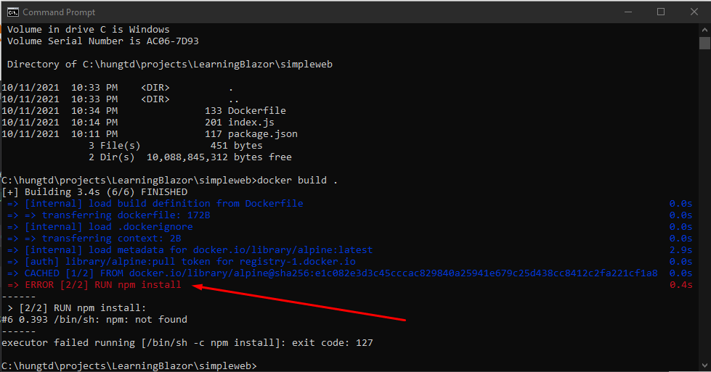
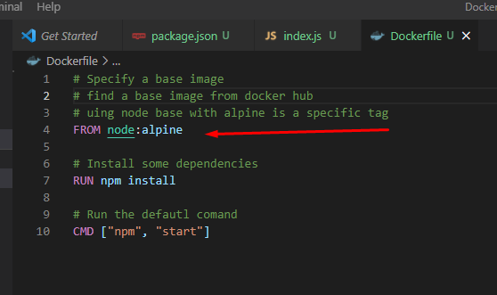
Build docker example (nodejs application)
RUN npm install not found
Solution 1: Find another image on Docker Hub including npm
Solution 2: Install more command to install npm

Slide 19
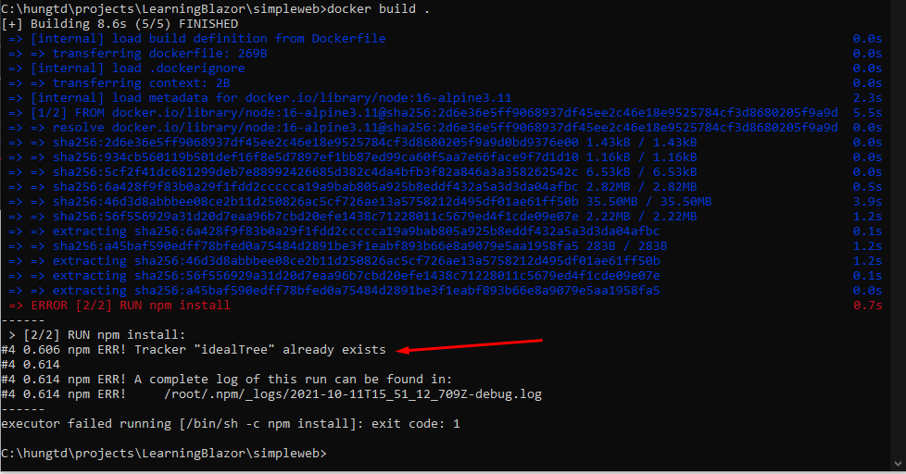
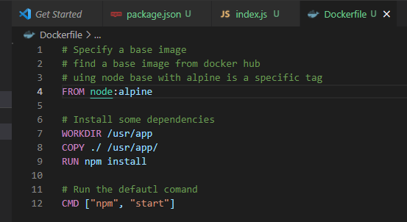
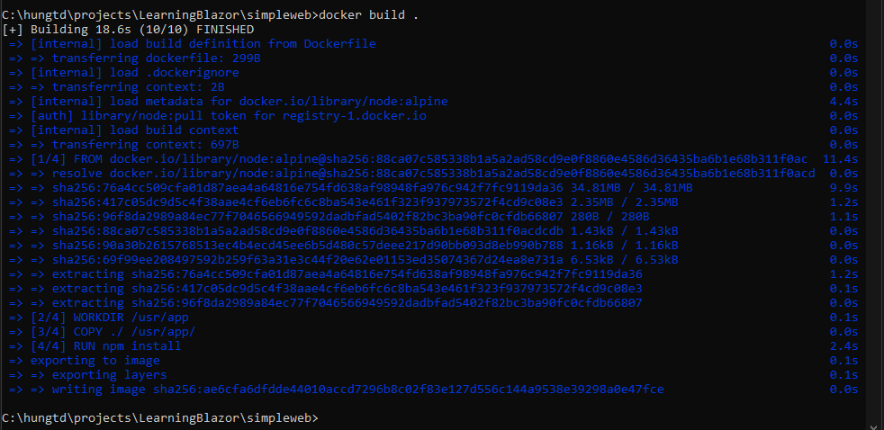
Build docker example (nodejs application)
npm ERR! Tracker "idealTree" already exists
This issue is happening due to changes in nodejs starting version 15. When no WORKDIR is specified, npm install is executed in the root directory of the container, which is resulting in this error.
Executing the npm install in a project directory of the container specified by WORKDIR resolves the issue

Slide 20
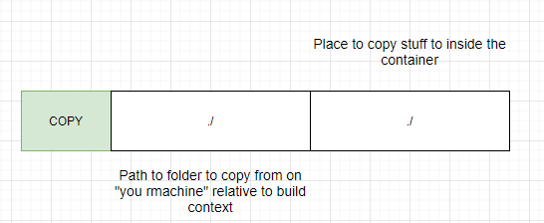
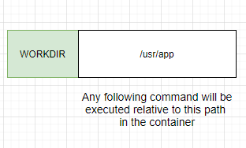
Build docker example (nodejs application)
Copy all files in the current build context folder to the folder inthe container

Slide 21
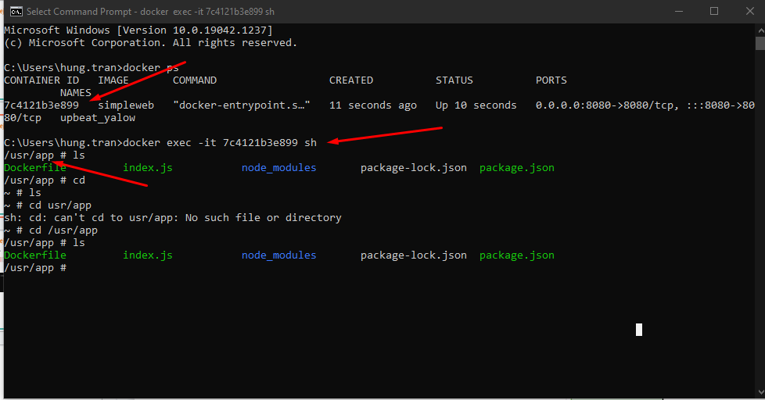
Build docker example (nodejs application)
Copy all files in the current build context folder to the folder inthe container
When run the container, the cursor point direct to the /usr/app directory

Slide 22
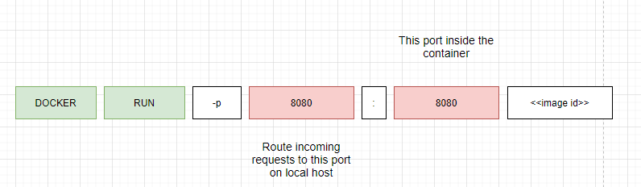
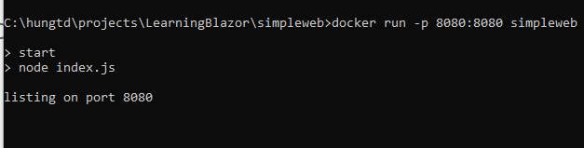
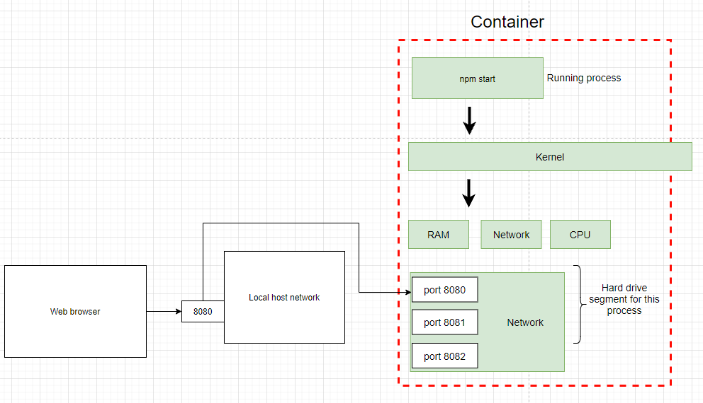
Build docker example (nodejs application)
Container port mapping and run in browser
Image’s Id or Image’s name

Slide 23
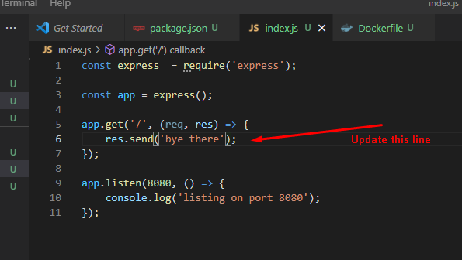
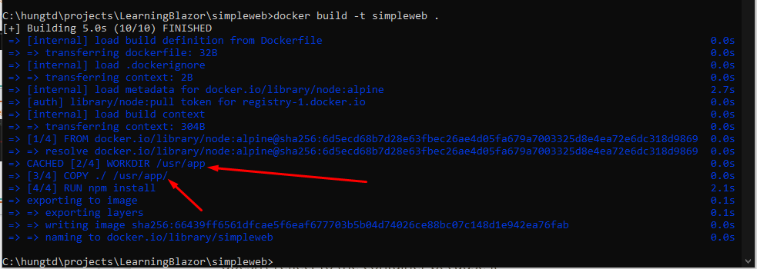
Build docker example (nodejs application)
When you update the file such as index.js. It doesn’t reflect to the container because it doesn’t copy snapshot to the container. We must rebuild manually.
While rebuild processing, Only the copy files are executed, other are execute from Cache

Slide 24
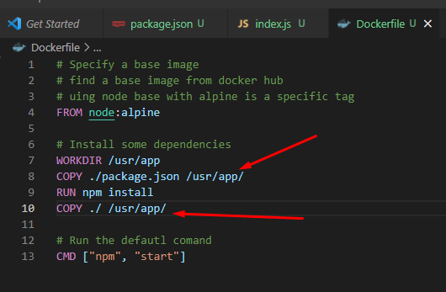
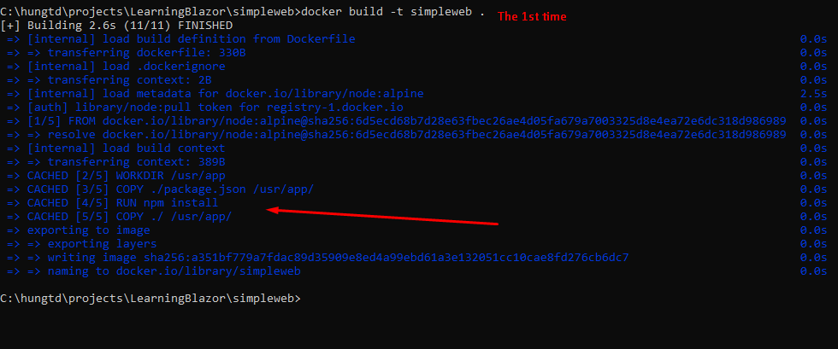
Build docker example (nodejs application)
The solution is copy the package.json before run npm install. It will cache this step and run from cache another time if don’t have any changes when rebuild the container

Slide 25
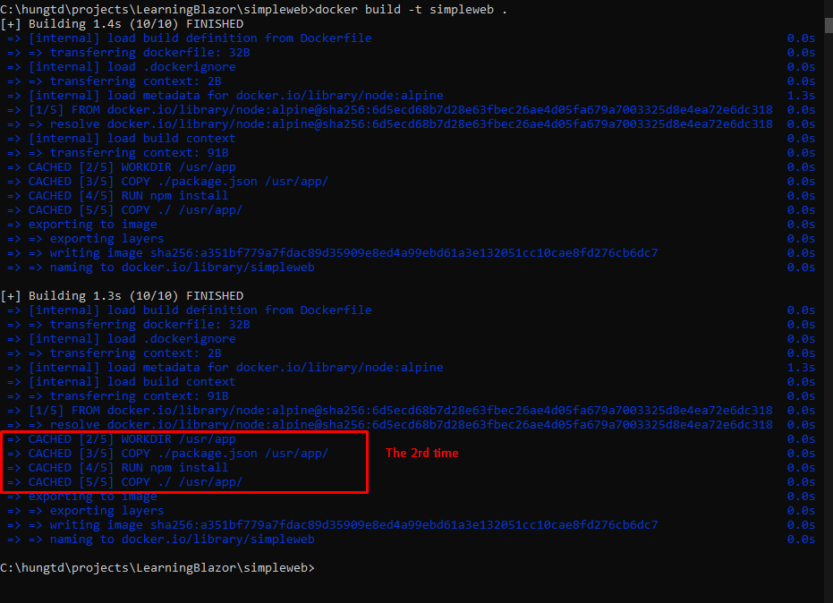
Build docker example (nodejs application)
The second time will execute from Cache. It help build faster in reality we have complicated process

Slide 26
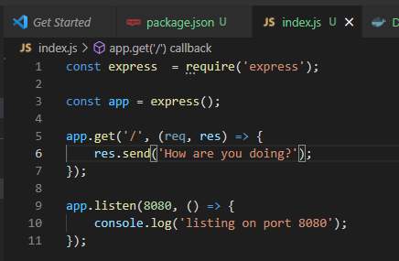
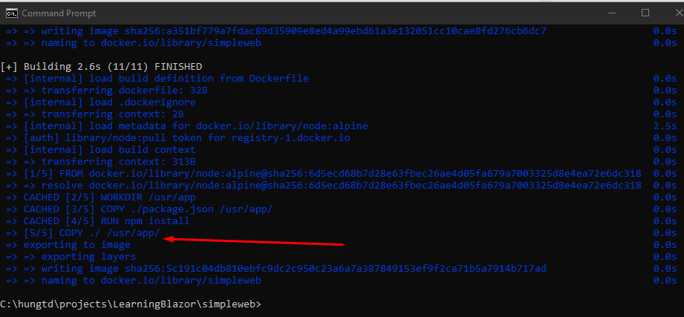
Build docker example (nodejs application)
We try to update index.js and rebuild again

Slide 27
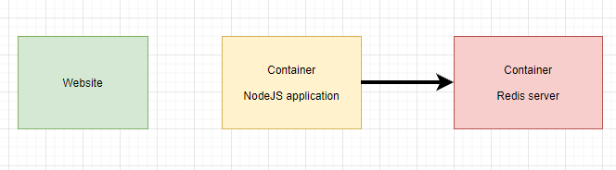
Build docker example (counter visit website)
Build a simple website run on nodejs and connect to redis server to save how many user access to the website

Slide 28
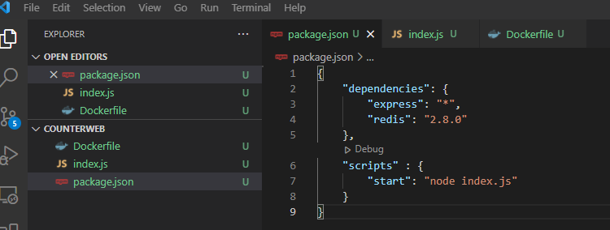
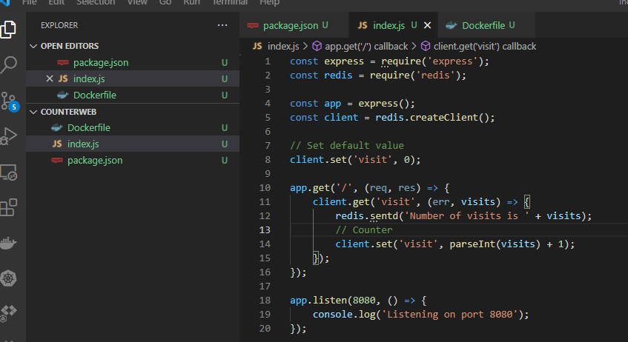
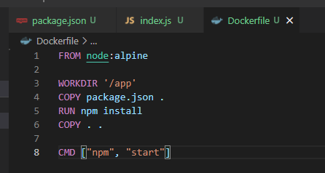
Build docker example (counter visit website)
Create new folder and build like these

Slide 29
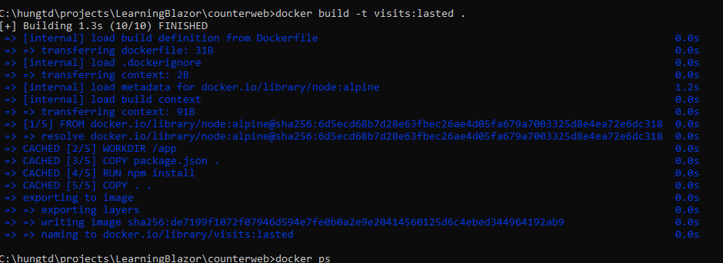
Build docker example (counter visit website)
Build an image with the tag name is visits:lasted

Slide 30
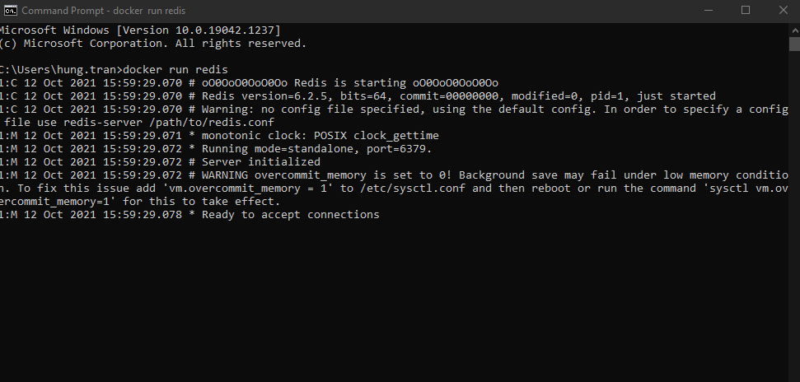
Build docker example (counter visit website)
Run redis server

Slide 31
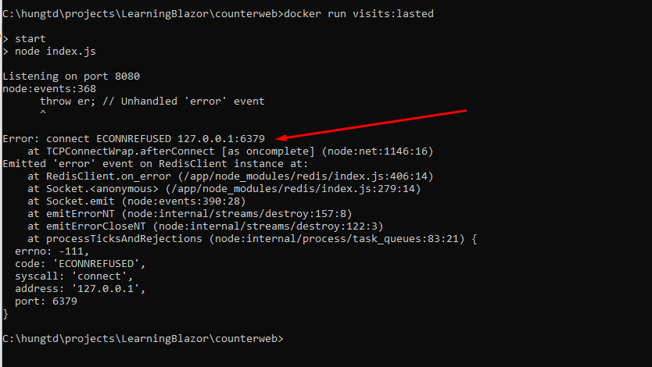
Build docker example (counter visit website)
Run node app
Get the error: can’t connect to redis server (the redis started)

Slide 32
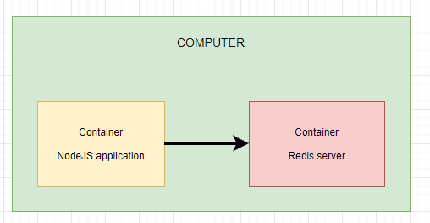
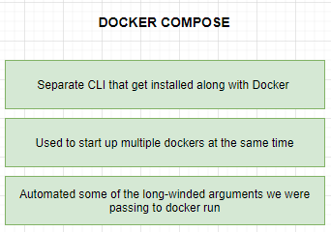
Build docker example (counter visit website)
In the computer, two container work independently. We have two options
1. Using Docker CLI network feature: It has a limit is we have to manual write a command to execute
2. Using Docker compose

Slide 33
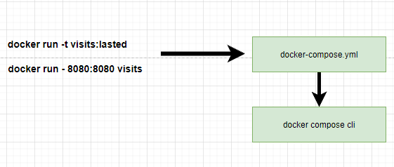
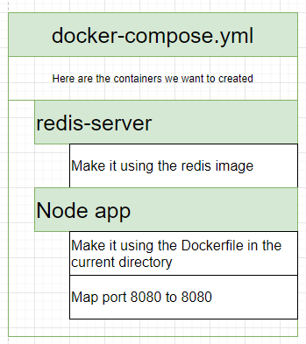
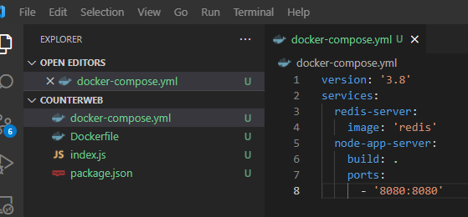
Build docker example (counter visit website)
Notes:
- We move the commands into the docker-compose.yml file which will be executed by docker compose CLI.
- services: means list of docker container you want to run

Slide 34
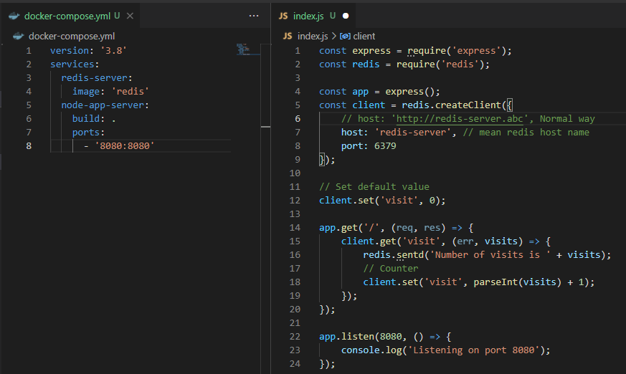
Build docker example (counter visit website)
Networking with docker compose

Slide 35
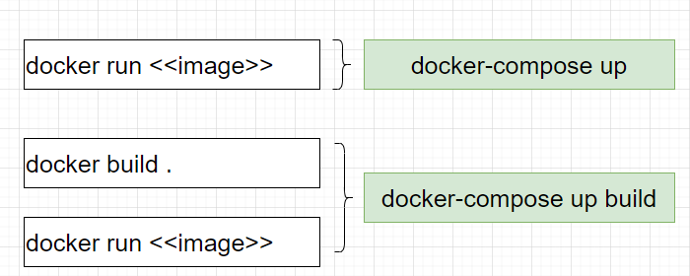
Build docker example (counter visit website)
Docker compose commands
Docker compose will read docker-compose.yml file to build the process

Slide 36
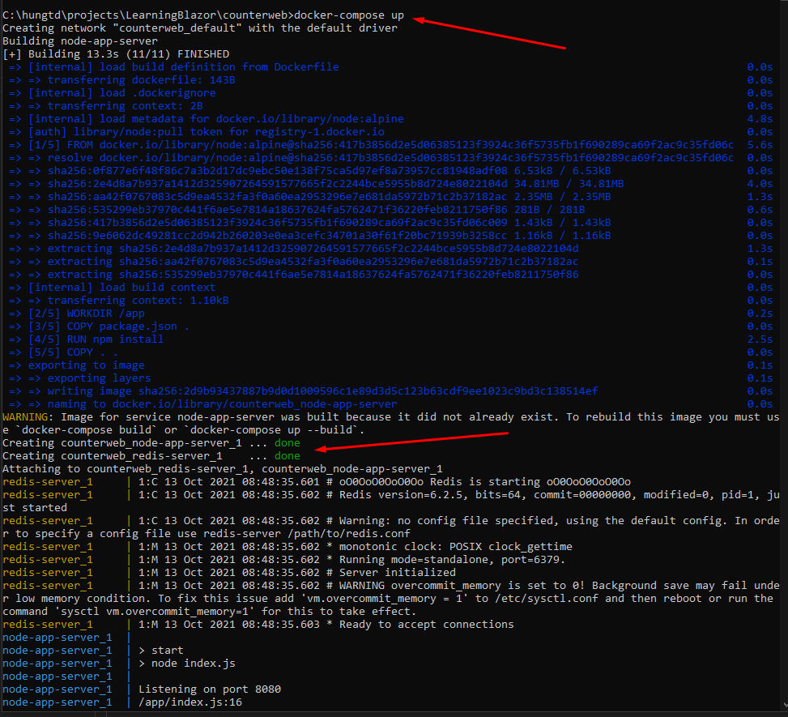
Build docker example (counter visit website)

Slide 37
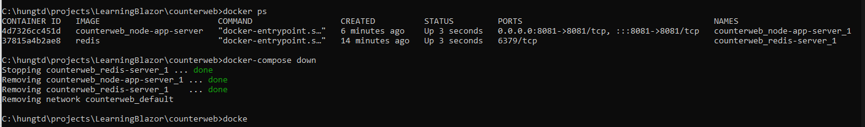

Build docker example (counter visit website)
stop docker compose

Slide 38
Build docker example (counter visit website)
Maintaince the container in cases crash or error

Slide 40

Docker run in detail

Slide 41

Overriding default commands
Run a command and show message
>> docker run busybox echo hi there
Notes:
we choose busybox becuase it has echo or ls command in its container.
hello-world is a single file container.

Slide 42

Overriding default commands
Show list of foder of the container
>> docker run busybox ls

Slide 43


Overriding default commands
Show list of foder of the container
>> docker run busybox ls

Slide 44


List of running container
Show list of running container
>> docker ps

Slide 45

List of running container
Show list of running container
>> docker ps
Show all containers that have ever been created on our machine
>> docker ps --all

Slide 46


Docker lifecycle
docker run hello-world

Slide 47


Docker lifecycle
docker run hello-world
Notes:
docker start -a hello-world
-a is a option, let the docker show the output coming from it and print it out at the terminal
docker run
=> is going to show you all the logs or all the information coming out of the container by default

Slide 48

Starting stopped container
Status = exited, mean it’s instance till exist in the cache, so we can recall it by using its ID
Notes:
check all container are running
>> docker ps --all
run busybox container
>> docker run busybox echo hi there
check all containers are running
>> docker ps --all
Restart a stopped container by using its ID
>> docker start -a ID
If you try to change the default command, it still show error
>> docker start -a ID echo hello

Slide 49

Starting stopped container
Notes:
check all container are running
>> docker ps --all
run busybox container
>> docker run busybox echo hi there
check all containers are running
>> docker ps --all
Restart a stopped container by using its ID
>> docker start -a ID
=> When run the container second time, The primary command will start automatically
If you try to change the default command, it still show error
>> docker start -a ID echo hello
=> It will show the error because the current primary command here cannot override

Slide 50

Removing stopped container
docker system prune
=> remove all stopped containers, cache and redownload images from docker hub

Slide 51

Retrieving log Outputs
docker logs <<container_id>>
=> With this command, we don’t re-run the container again. It only emitted what it works

Slide 52
Retrieving log Outputs
docker logs <<container_id>>
=> With this command, we don’t re-run the container again. It only emitted what it works

Slide 53

Stopping container
First, create, run and view log of the container

Slide 54


Stopping container
Notes:
stop and kill are used to stop and kill a container. But it has a different
when use stop command, a hardware signal sent to the primary process inside the container (SIGTERM mean terminate signal) to let the container know to shutdown now with a little bit time to clean up the conainer (save files, or emit some messages,...)
- if the container does not stop in 10 seconds, it wil call kill command.
kill command: to sent a signal to the primary container to kill the container immediatelly.

Slide 55

Stopping container
>> docker stop <container_id>
Waiting for over 10 seconds to stop the container

Slide 56

Stopping container
Start container again and use kill command
>> docker kill <container_id>
Stop the container immediately

Slide 57

Multi-Command container
First, Settup redis on docker
>> docker run redis

Slide 58


Multi-Command Container
try to run redis-cli but it’s not working because the command run outside the container

Slide 59



Multi-Command Container

Slide 60
The purpose of the “IT” flag
try to run redis-cli but it’s not working because the command run outside the container
Notes:
When you run a docker in your local machine, every single container that you are running is running inside of a virtual machine running Linux
So these process are really being executed inside of a Linux world, even if you are on Mac or Windows

Slide 61


The purpose of the “IT” flag
-i: make sure that any stuff that you type gets direct to STDIN
-t: help to show up the result pretty
Notes:
STDERR: communicate to other outside invironment and return the data and show on the terminal

Slide 62

Getting a Command Prompt in a Container
>> docker exec -it <container_id> sh
open a Command Prompt to execute some command

Slide 63

Getting a Command Prompt in a Container
>> sh
Is a name of a program and it’s a program that has been executed inside of that container
Open a Command Prompt to execute some command inside a container

Slide 64

Starting with a Shell
>> docker run <image_name> --it sh
Start a new shell when run new container

Slide 65


Starting with a Shell
Notes:
run two commands are the same to check its container are shared folder or not

Slide 66
THANKS FOR LISTENING

